Slide 1
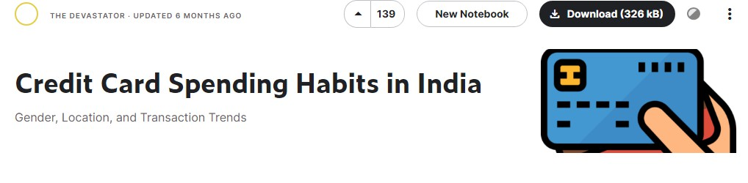

SQL PROJECT
Presented by Pooja Pawar
Solutions are Coded in - Microsoft Sql Server

Slide 2



Introduction
This dataset contains insights into credit card transactions made in India, offering a comprehensive look at the spending habits of Indians across the nation
City: The city in which the transaction took place. (String) Date: The date of the transaction. (Date)
Card Type: The type of credit card used for the transaction. (String)
Exp Type: The type of expense associated with the transaction. (String)
Gender: The gender of the cardholder. (String) Amount: The amount of the transaction. (Number)

Slide 3

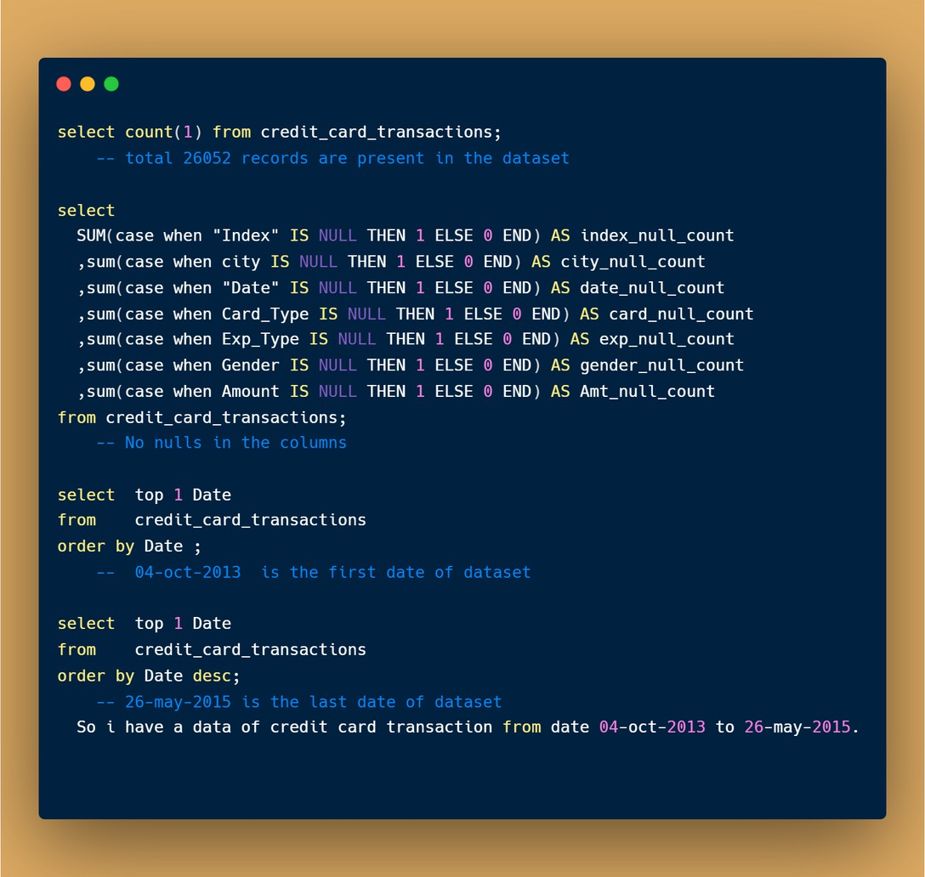










Start with some basic EDA - total records , find nulls in dataset etc.

Slide 4
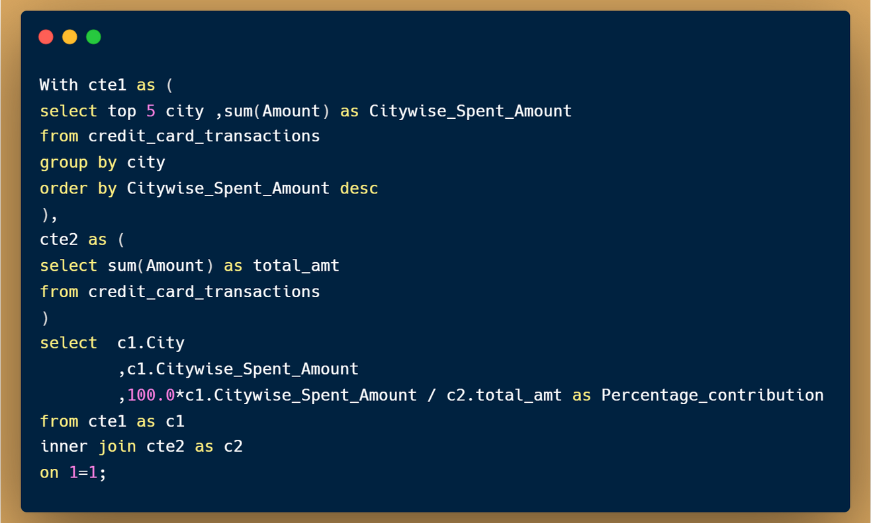
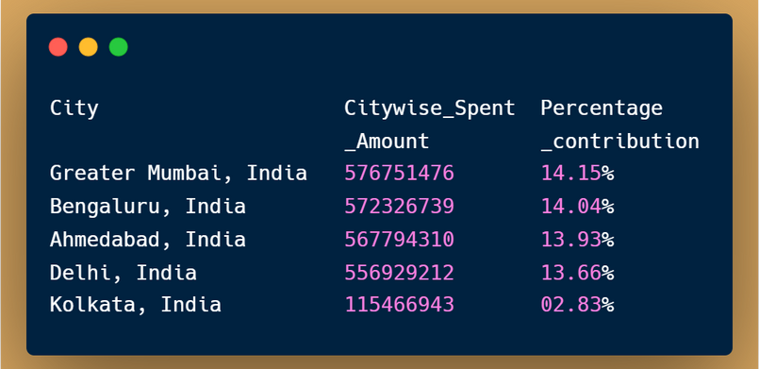



1. write a query to print top 5 cities with highest spends
and their percentage contribution of total credit card spends?

Slide 5
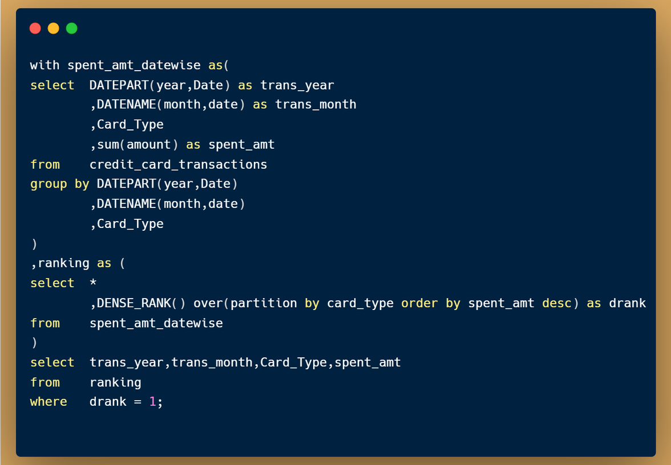
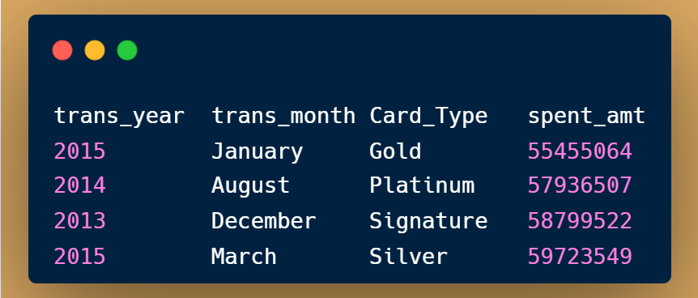

2. write a query to print highest spend month and amount spent in that month for each card type

Slide 6
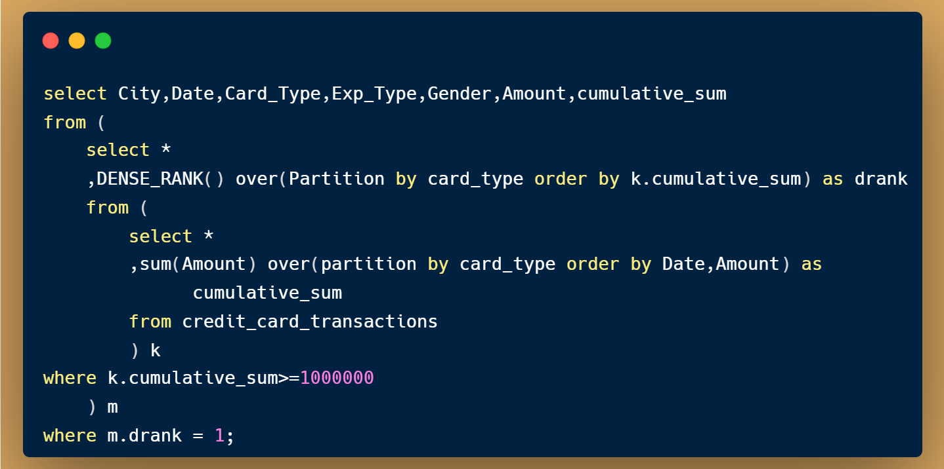

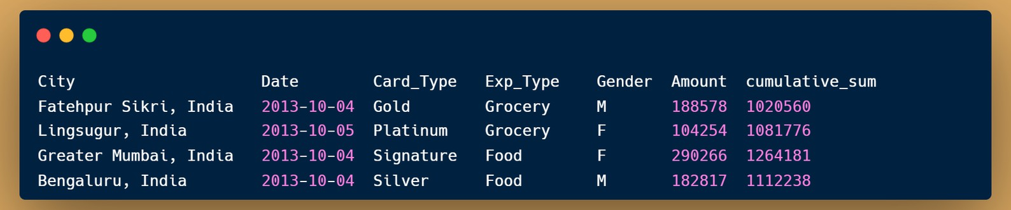

3. write a query to print the transaction details(all columns from the table) for each card type when it reaches a cumulative of 10,00,000 total spends(We should have 4 rows in the o/p one for each card type)

Slide 7
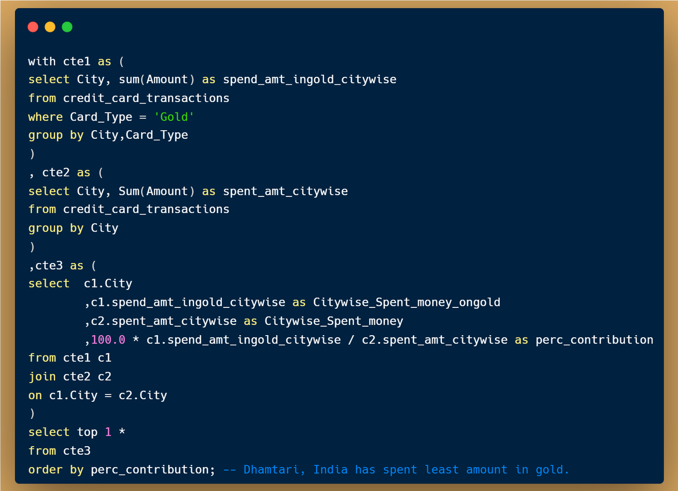
4. write a query to find city which had lowest percentage spend for gold card type

Slide 8
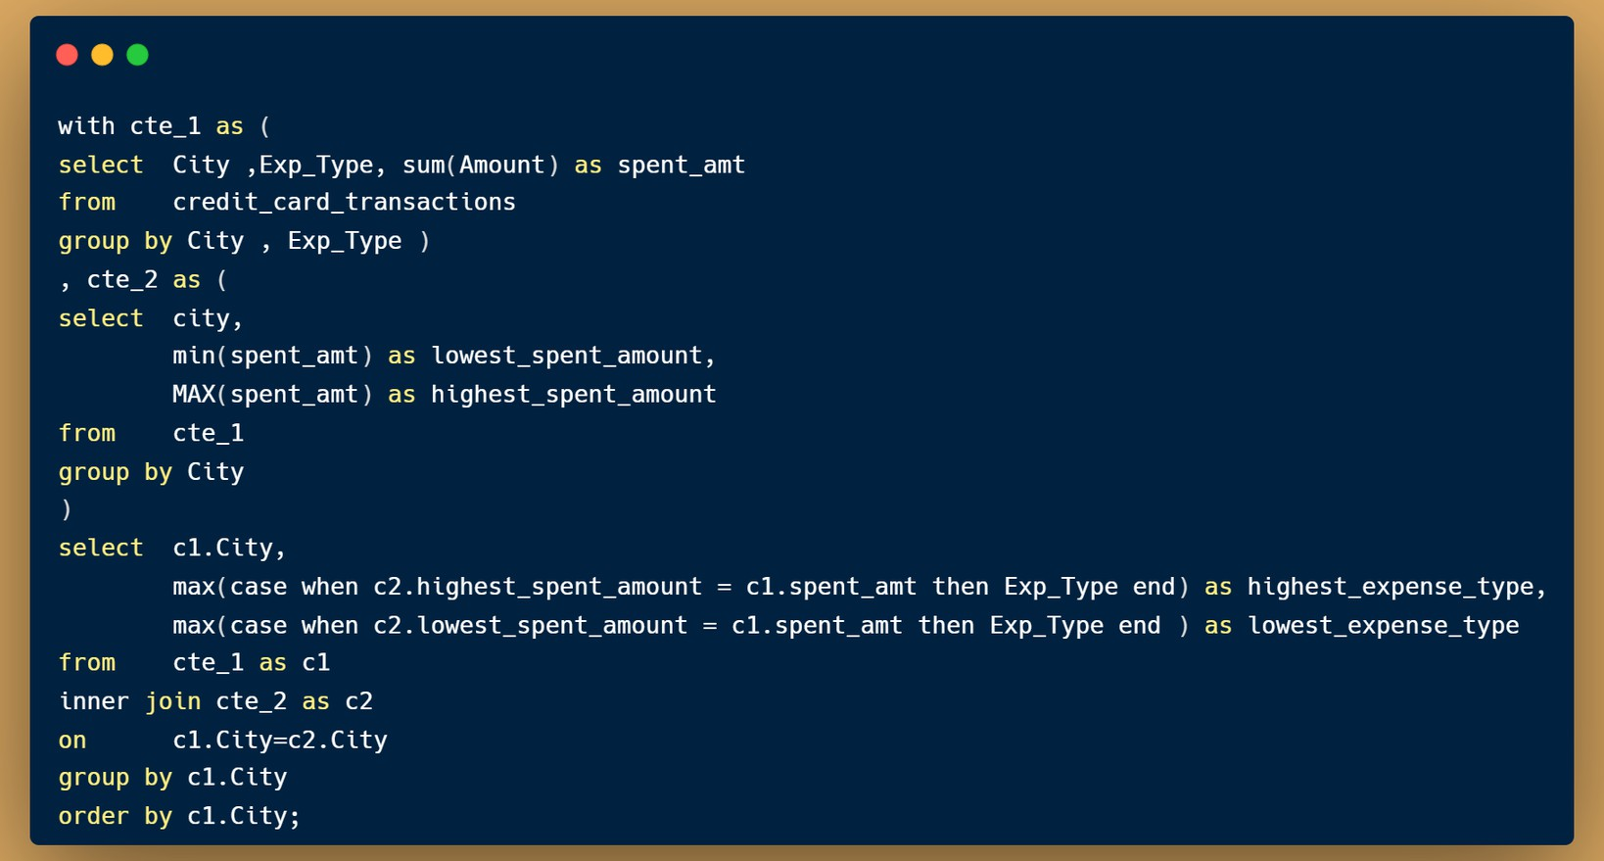
5. write a query to print 3 columns: city, highest_expense_type , lowest_expense_type (example format : Delhi , bills, Fuel)

Slide 9
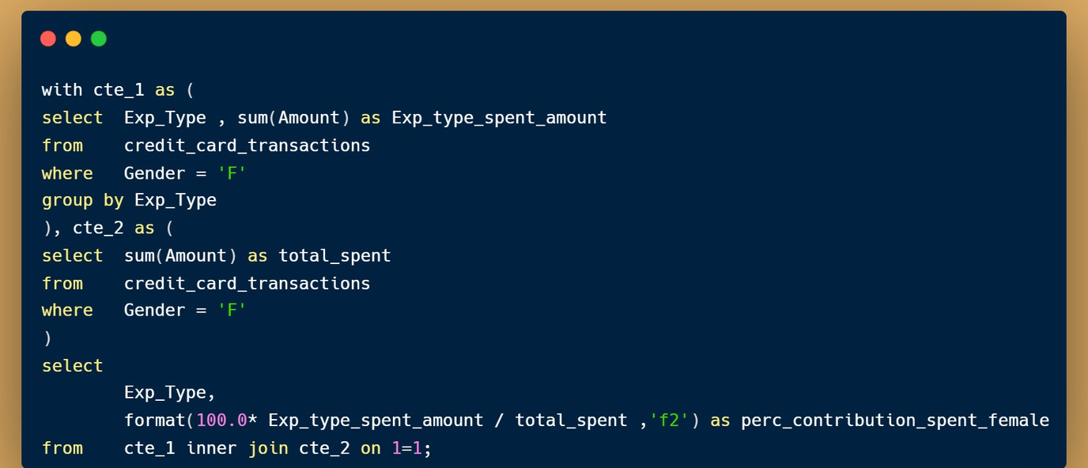
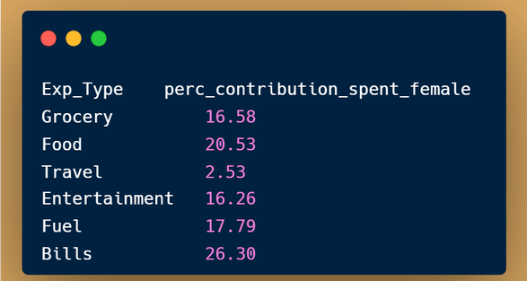
6. Write a query to find percentage contribution of spends by females for each expense type.

Slide 10
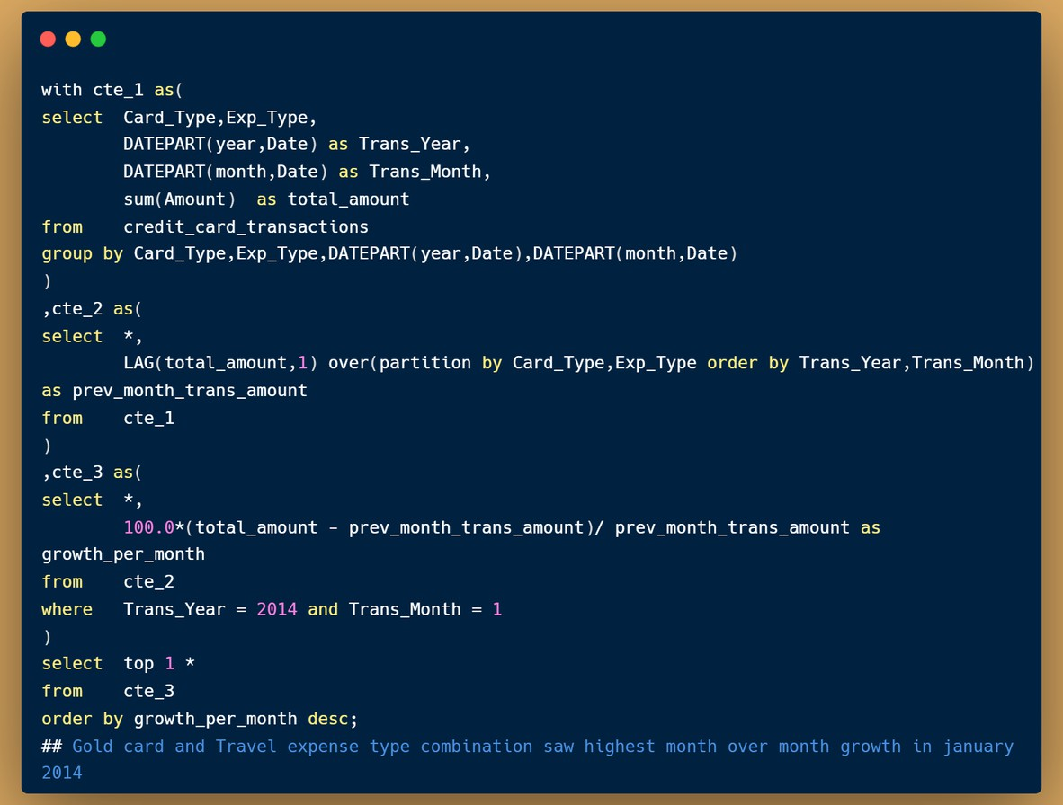
7. which card and expense type combination saw highest month over month growth in january 2014?

Slide 11
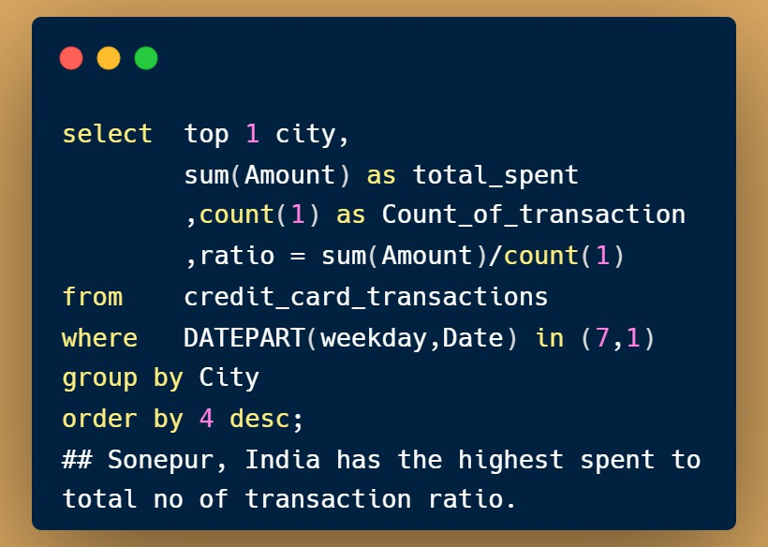
8. during weekends which city has highest total spend to total no of transcations ratio

Slide 12
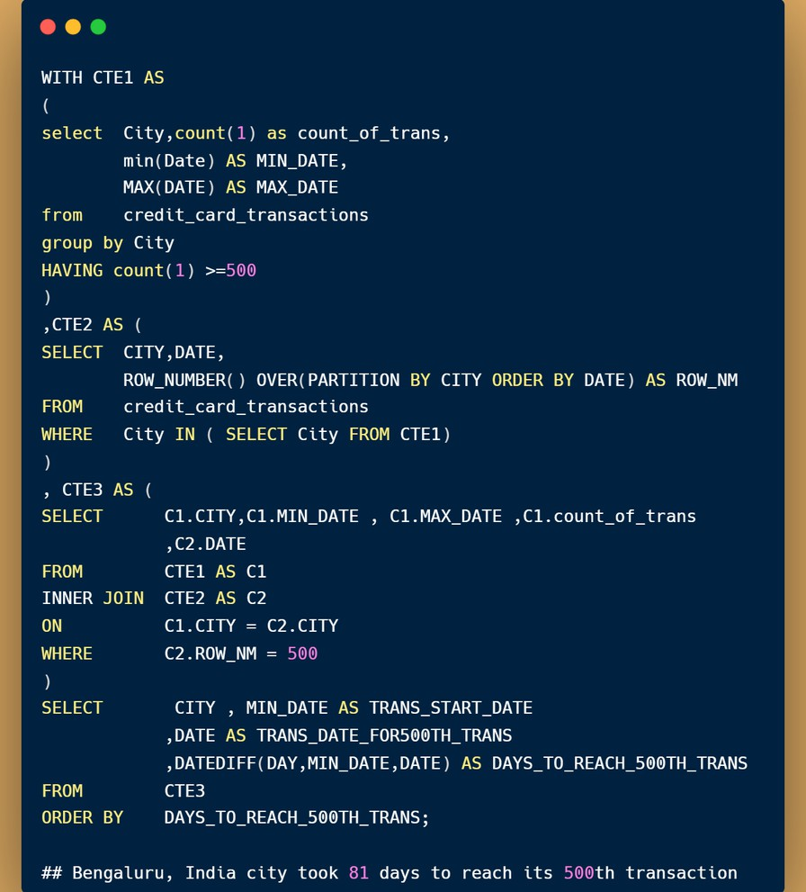
9. which city took least number of days to reach its 500th transaction after first transaction in that city

Slide 13
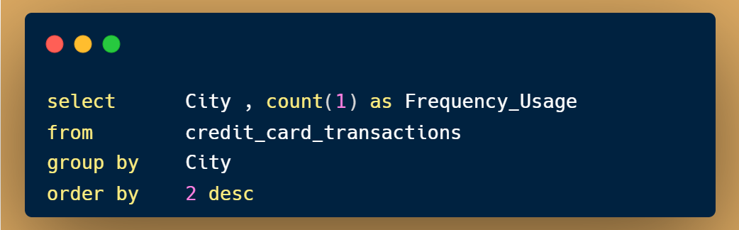
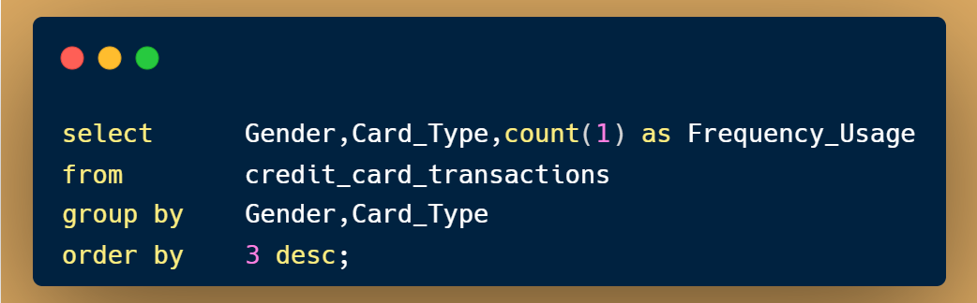
10. Show me the Transactions frequency on each city
## Bangalore, Greater Mumbai, Ahmedabad & Delhi are those cities where transactions are more
11. Show me the transaction frequency by Gender and credit card type
## Female category used more credit card as compared to male category.

Slide 14

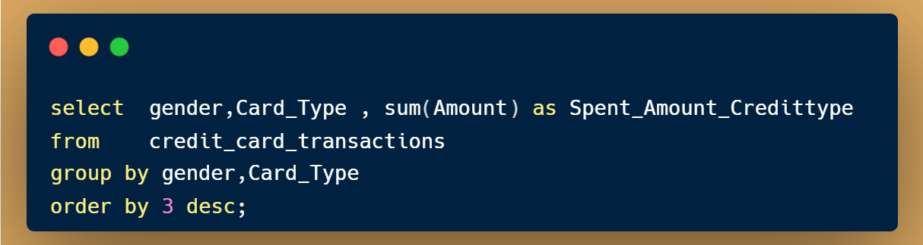
12. Show me the transactions frequency by Expense type and Gender
## Food, Fuel , Entertainment , Grocery & Bills are the main Expense type on which Users did Transactions
13. Show me the Amount Spent by Gender and credit card type
## Female category Spent more money via Silver Credit card type
and male category Spent more money via Platinum Credit card type

Slide 15


Call to actions
Allocate additional marketing resources and promotional campaigns to the top 5 cities to capitalize on their high spending patterns.
Plan targeted promotional offers or campaigns during the highest spending months for each card type to encourage increased spending.
Investigate the reasons behind the low spending in the identified city and consider targeted marketing strategies or partnerships to increase spending in that location.
Allocate additional staffing or resources in the city with the highest spend-to- transaction ratio during weekends to capitalize on increased spending opportunities.
Identify market potential and consider targeted marketing efforts in the city with the fastest transaction growth to capture new customers and increase business growth.
Develop specific product or service offerings targeted towards females based on their significant contribution to spending in specific expense categories.

Slide 16





